Slide 1
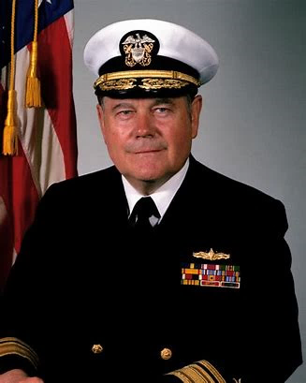
Meyer Scholar Program
est. 2019
Rear Admiral Wayne E. Meyer
Father of AEGIS
Notes:
The Meyer Scholar Program was initiated at NPS in 2019.
It’s named for the Father of AEGIS, Rear Admiral Wayne E. Meyer.
Admiral Meyer was a distinguished graduate of the Naval Postgraduate School and instrumental in developing the world’s longest and most successful warship construction program. Today there are over 100 AEGIS ships in the service of the U.S. and other foreign navies.
The Meyer Scholar program is all about developing officers like Admiral Meyer who started here at NPS.

Slide 2
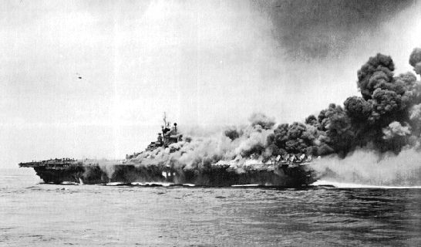

Slide 3
EXPEDITIONARY ADVANCED BASE OPERATIONS

Slide 4
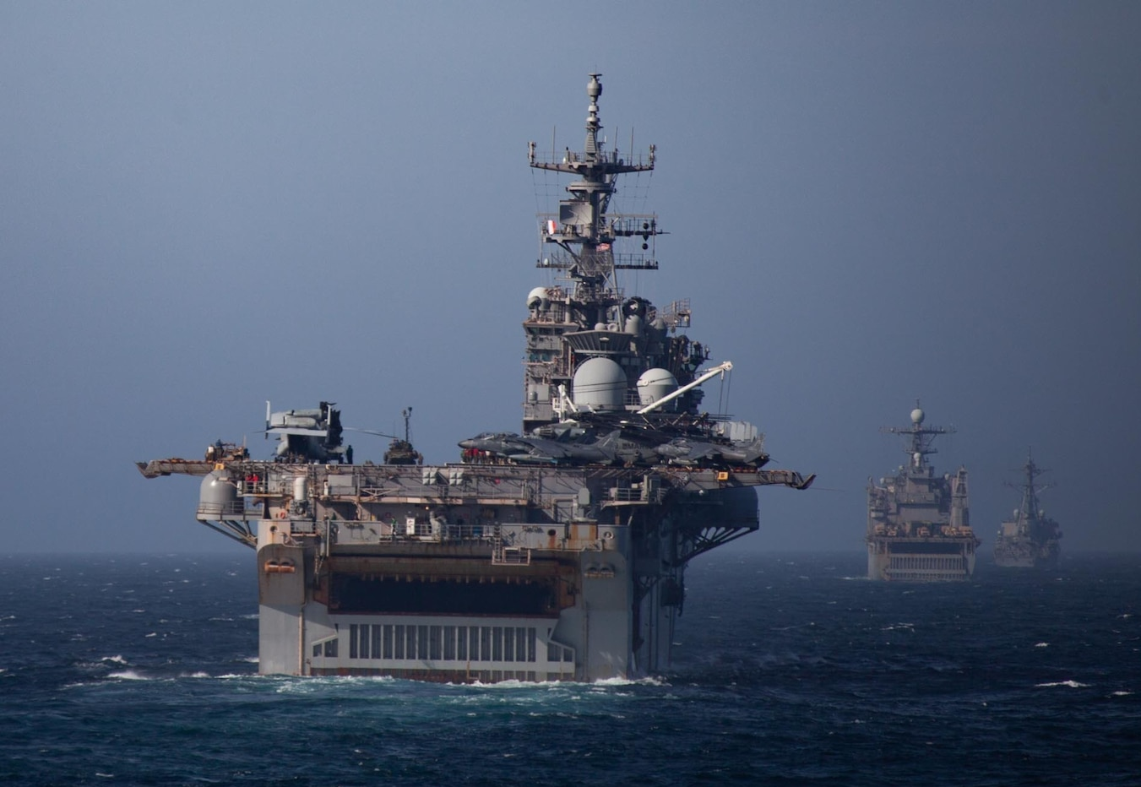
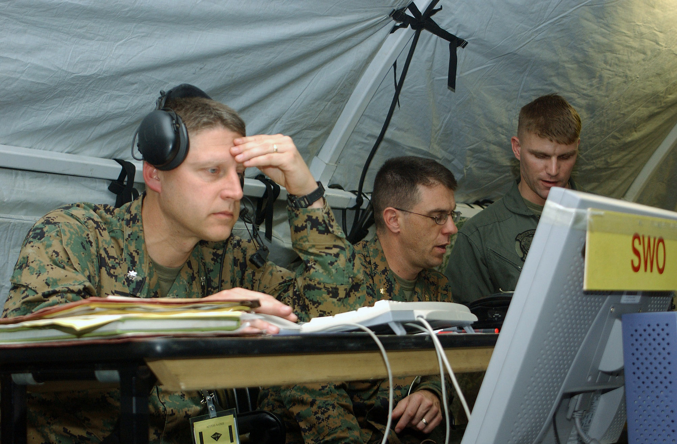
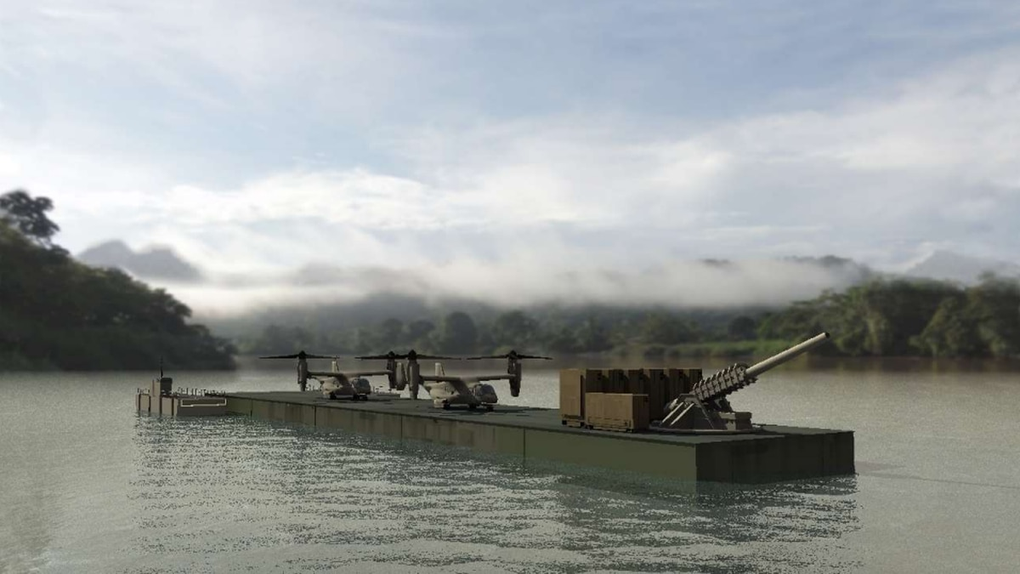
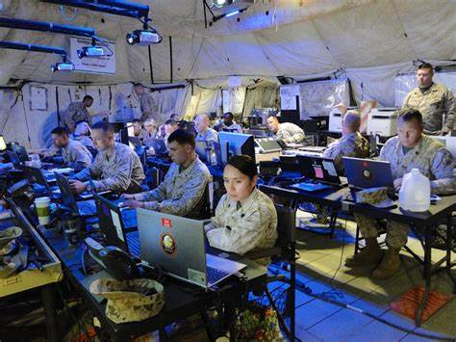

Slide 5
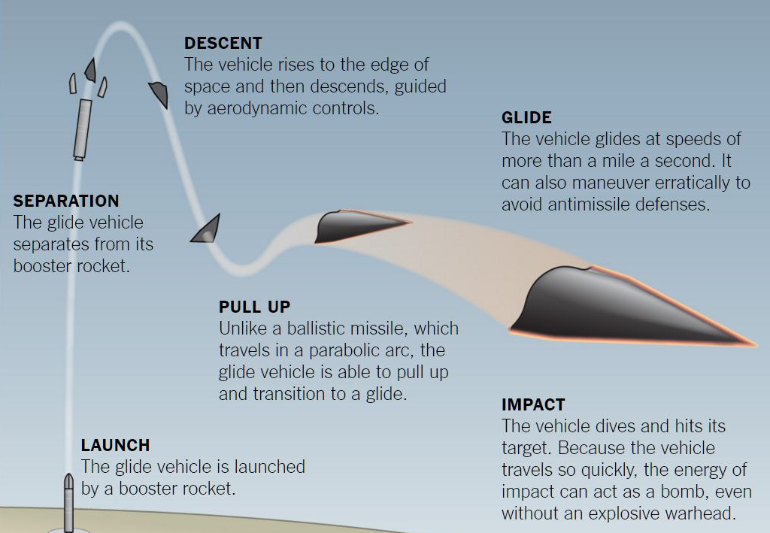
Why Meyer Scholars?
Hypersonic Glide Vehicle
The Air and Missile Threat is Real and Growing
Proliferation of missile technology
Hypersonic Threats
Smaller signatures
Longer ranges
Mass raids
Cyber complexities
Unaffordable Offense/Defense Costs
There is an urgent need for officers who are exceptionally well qualified in integrated air and missile defense related disciplines to lead operational, resource, requirements, and engineering efforts necessary to develop & employ highly sophisticated integrated air and missile defense capabilities.
Increasing technical sophistication demands more, well-educated officers
Notes:
A good first question might be why was the Meyer Scholar program established. There are two main reasons .
The first is that the proliferation of advanced technology to adversaries and their exploitation of that technology has resulted in air and missile threats making it challenging to achieve the air superiority necessary to enable the Fleet to accomplish its assigned missions. Countering advanced air and missile threats requires extraordinarily sophisticated IAMD capabilities. Naval officers expert in the development and employment of these capabilities are urgently required.
Unfortunately, there are very few officers with this expertise at the graduate level. It takes significant education and experience over many years to develop the right balance of technical and operational expertise. Getting the right education early on enables officers to contribute to the solutions of these very difficult operational and technical problems.
You can help us and we can help you be a better TAO, Combat Systems Officer, Commanding Officer, Resource Officer and Branch Head when it comes to IAMD specifically and combat systems in general.
Just as you would want to have the best heart surgeon possible operating on your loved one, we want the most highly qualified officers developing and employing the sophisticated IAMD systems necessary to protect our ships and their Sailors.

Slide 6
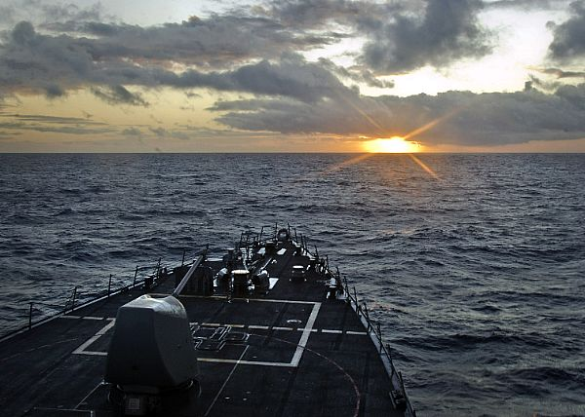
Closing the Gap
Recruit more officers inside NPS
Resurrect proven principles based on FOA’s Wisdom
Provide more combat systems learning opportunities
Relentlessly Strive for Professional Excellence

Slide 7
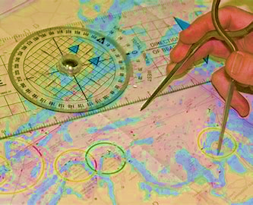
Closing the Gap -The Big Four
Seminar Program
On-line Courses
Combat Systems Engineering Course
Thesis

Slide 8
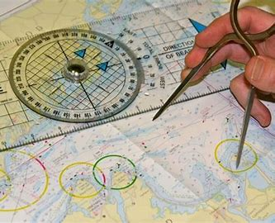
Seminars
Operational IAMD – Commander Task Force 64
MTMD At-Sea Demo Interoperability - PEO IWS
SPY- 6 Radar - Raytheon
SM - 3 Missile – Raytheon
SM - 6 Missile – Raytheon
Naval Warfare Systems Interoperability – NSWC/ DD
Joint Interface Control Officer – Missile Defense Agency
IAMD Threat Intelligence Week – NSMWDC
MTMD Forum Engineering & National Representative Technical Interchange Meeting – PEO IWS

Slide 9
On-line Courses
Joint BMD Training and Education Center - Ballistic Missile Defense
MIT Lincoln Labs - Introduction to Radar
Joint Knowledge Online - Joint Multi-TDL Network Operations

Slide 10
TS 4000 Naval Combat Systems Engineering
Representative Topics
National Security Strategy
National Strategic Economic Overview
DoD Decision Support Systems
Case Study: AEGIS Program*
Combat Systems of Systems, Systems, and Elements
Systems Engineering Process
AEGIS Weapon and AEGIS Combat System
Cooperative Engagement Capability
Naval Integrated Fire Control
Ballistic Missile Defense System
Combat System Development
Combat System Ship Integration
Naval Warfare System Interoperability
Combat System Test and Certification
Combat System Life Cycle Support
* From ASNE Journal, Special Edition, “The Story of AEGIS”

Slide 11
Recent Meyer Scholar Theses
Characterization of Space-Based Capabilities in Wargaming
SPY-1 Reliability *
5G Tactical Communications
Characterization of Land Sea Interface Impact on High Energy Laser Performance
A Space-Based Ballistic Missile Defense System
CMAS (CaO-MgO-Al₂O₃-SiO₂) Attack Characterization on Ultra High Temperature Ceramics
* Surface Navy Association Award for Best Thesis

Slide 12
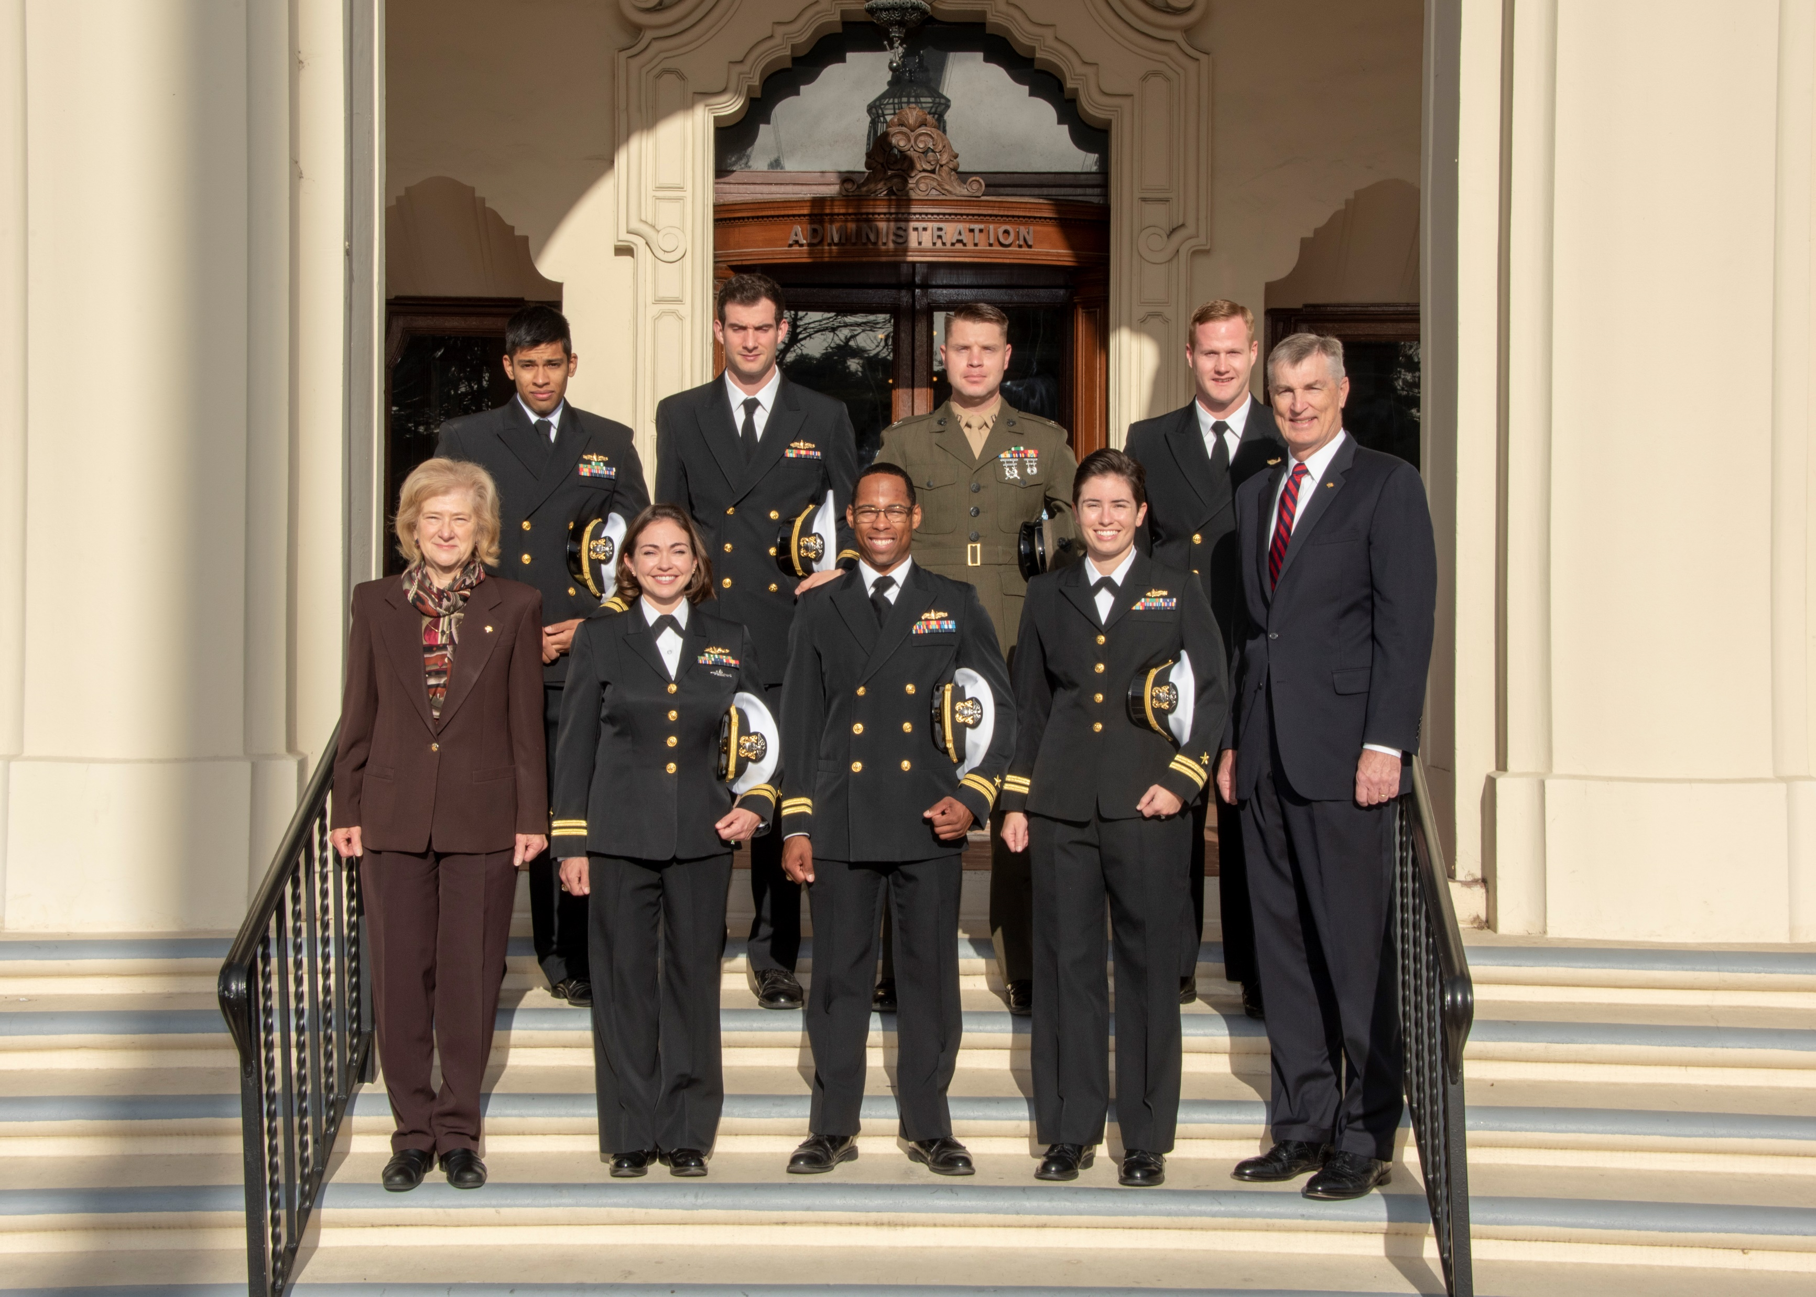
2021 Meyer Scholars
LT Patrick Larson
Capt Jonathan Monti
LT Mario Negron Perez
LT Levi Rosa
LT Erick Samayoa
LT Matthew Searight
LT Jonathan Shepherd
LT Scott Snowden
LT Russell Sunda
LT Jimmy Wickham
LT Lucas Woods
LCDR Allison Pelosi
Maj Michael Smithson
LT Sasha Barnett
Capt Andrew Benton
Capt Benjamin Branson
LT Ashley Edmond
LT Jessica Fonseca
LT JC Hanisko
LT Lewis Jerrils
LT James Kornowski
Capt Tim Zebrowski
Executive Director - LCDR Brian Curran
VADM Eli T. Reich Fellow - LCDR Mike Green, USN (Ret)
Notes:
EDO = 5 SWO = 11 USMC – 4 METOC – 1

Slide 13
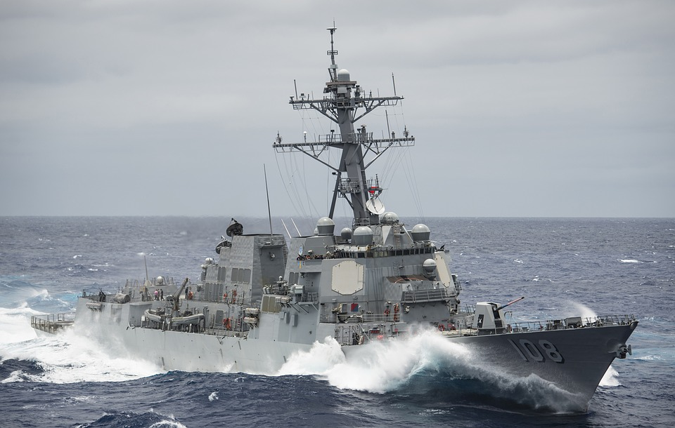
Meyer Scholars
See, email, or call :
Capt Andrew Benton
Meyer Scholar Accession Officer
andrew.d.benton@nps.edu
Or
John Hammerer
Spanagle 200A
John.hammerer@nps.edu
571-435-3244
Notes:
The Navy needs many more officers with a high level of technical and operational expertise in IAMD and Combat Systems because new sophisticated threats require the development and employment of advanced combat systems capabilities by exceptionally well qualified officers.
You can follow in the footsteps of officers like Admiral Meyer and his modern day successors like VADMs Jon Hill, Director of the Missile Defense Agency and John Nowell, Chief of Naval Personnel, RADM Doug Small, PEO Integrated Warfare Systems and RDML Tom Druggan, Program Executive, AEGIS BMD. They all started their journeys here at NPS.
If you’re interested in being a Meyer Scholar and getting started on a path to success, please let us know.

