Slide 1
Pre-departure brief
Download a ‘Check-Out Sheet’ from the NPS Student Forms Webpage
https://nps.edu/web/students/forms
Soon it will be time to depart… so prepare NOW!

Slide 2
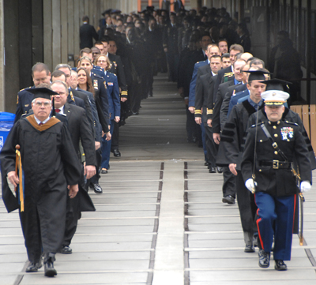
Pre-departure Brief
Student Services Office

Slide 3
CAPT Eric J. Skalski
Dean of Students

Slide 4
Common Friction Points
Late submission of transfer packages
Uncompleted medical screenings
Last minute changes to transfer dates or travel plans
Uncompleted check out sheets
Communicate early!
Last minute requests – Tell your Program Officers
  Thesis Extensions
  Staying >7 Days after graduation?

Slide 5
What to do and expect
All U.S. military students
Begin Check-Out Sheet
  Turn-in to Student Services at check out via email NET 48 hours prior to your departure
  Most offices support check out virtually
Staying in Monterey >7 days after graduation..?
  submit DOS Request Form
  inform Program Officer, Service Representative, etc.
Thesis extension..?
  submit Thesis Extension Request
  if in doubt, submit thesis extension request to be safe
NPS account access remains active for 90 days after check out, unless needed for exceptional circumstances. (POC: NPS TAC)
Reminder: firearm laws & regulations --
not allowed on base, so plan ahead (if applicable)

Slide 6
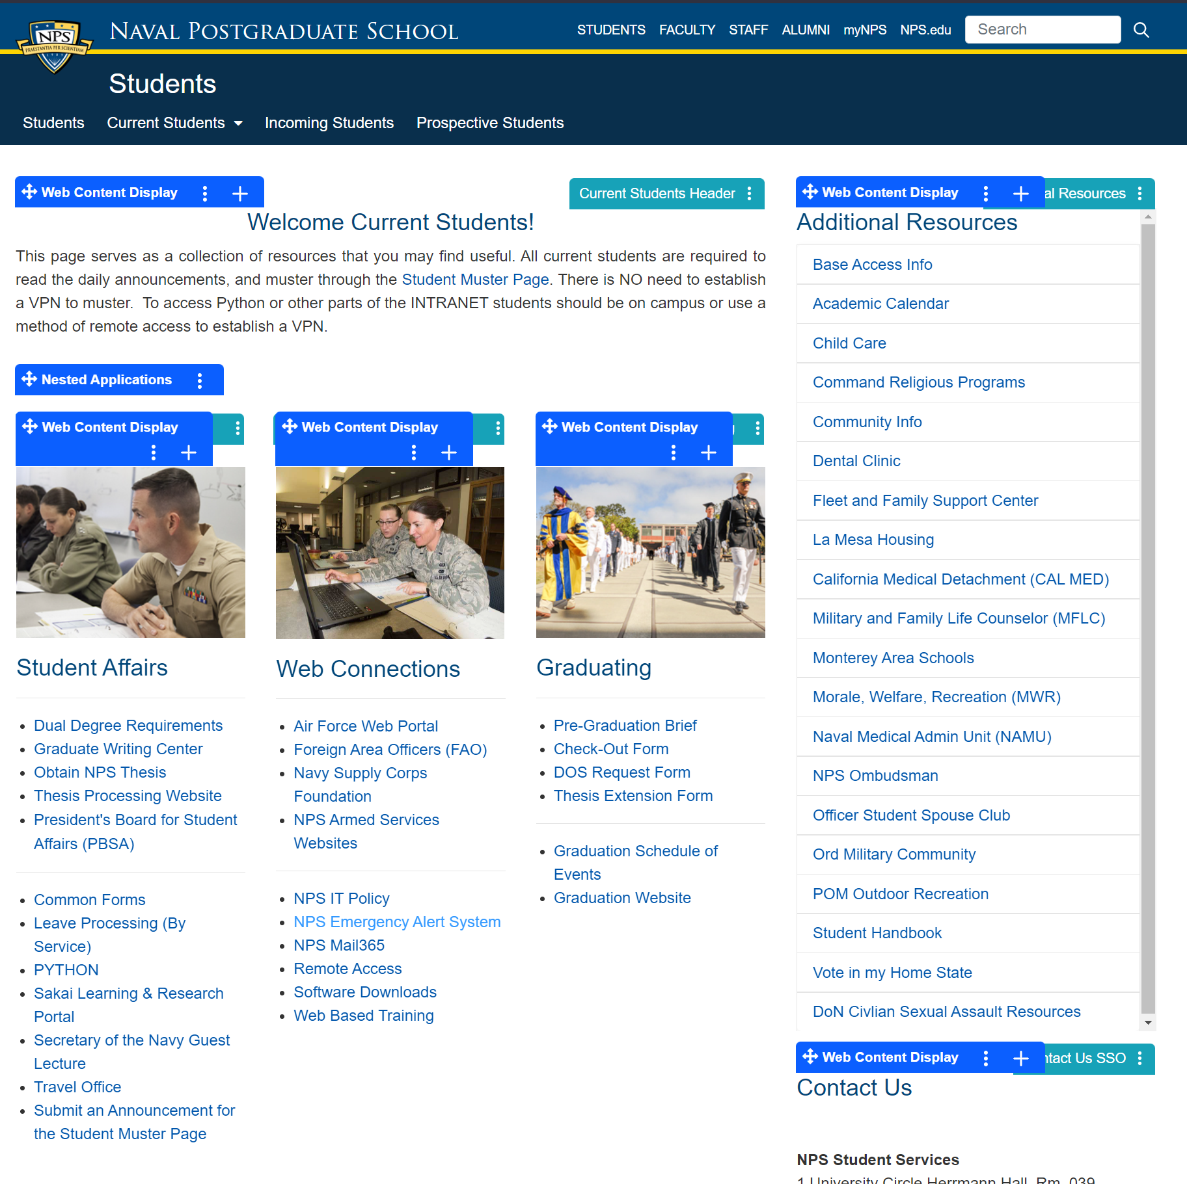
Where can I find a check out sheet?
NPS.EDU/web/Students/current-students
Here!

Slide 7
Checkout sheet
Checkout items
Library (all)
Student Services (all)
Naval War College (JPME)
Motorcycle Safety (riders only)
[email: chris.robare@nps.edu]
Command Fitness (US Navy)
FITREP (US Navy); final copy will be included in transfer packet
Travel Office (all); start now!
Command Security (all)
NPS Registrar (all)
Admin units (all)
Education Technician (all)
Dental/Medical (all)
Urinalysis (all); 1-to-3 days
before detaching
Do not start checking out until your final week
(except for travel)

Slide 8
Checkout sheet (cont’d)
You are not checked out until your checkout sheet is turned in to
Student Services
*turn in 1-to-2 days prior to departure
sa@nps.edu

Slide 9
Medical
NO hand carrying of medical or dental records with the following exceptions:
Service members traveling overseas on permanent change of station orders, that specify records are to be hand carried.
A Medical Treatment Facility Commander determines that it is in the best interest of patient care to allow for hand-carrying of paper medical records.
Service members performing temporary duty where the full medical records are required.
If the service member can provide documentation (i.e. orders) stating they need to hand carry records they will be able to.
If you believe you need to hand carry your records and you do not fall under one of the above criteria, please begin the process early to either have an orders modification or get permission from a MTF Commander.

Slide 10
Security Clearance
Review orders for specific clearance needed to perform your duties in your next command.
Check to see if it is close to expiring or has expired.
See the Security Manager’s Office early to initiate your security investigation.

Slide 11

Base Access
Notes:
Good afternoon. I am Carleen Wells and I am the APC here at NPS. The Travel Office requires you to check out with us prior to departing. I am going to walk you through the check out process now.

Slide 12
Base Access Requirements for Guests
NSA Monterey has a 100% ID check policy
NPS Graduation is NO LONGER COVERED by a General Public Visit
All guests 18 and older will either need to be escorted by a trusted traveler or the preferred method is for them to be vetted prior to arrival.
Note: All overnight Hotel Del Monte Guest guests are required to be vetted!
Guests who do not have a valid ID will be denied access to NSA Monterey.
Guests who do not have a pass or are not escorted by a trusted traveler will also be denied access.
Escorts must remain with their guests AT ALL TIMES.
Sponsors are responsible for the actions of their guests while they are on the installation.

Slide 13
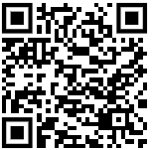
Base Access Requirements (Cont.)
All vetting must be conducted by NSA Monterey’s Visitor Control Center.
Follow the instructions at:
https://nps.edu/web/base-police/vehicle-gate-access-services
Fill out the highlighted fields on the SECNAV 5512/1 form, including:
  The Guest’s Social Security Number and a second form of ID
  All non-US Citizens must provide their passport as a second form of ID
  Sponsor’s (your) DOD ID number at the bottom of the page
  Sign the document and send it encrypted to vcc@nps.edu
It takes up to 9 business days to return a vetting result. Please get your SECNAV 5512s in early.
The sponsor is responsible for picking up the passes for their guests from the VCC during working hours (M-F 0730 – 1500, lunch 1130 – 1200).

Slide 14
Travel Office
Notes:
Good afternoon. I am Carleen Wells and I am the APC here at NPS. The Travel Office requires you to check out with us prior to departing. I am going to walk you through the check out process now.

Slide 15
Check Out Process
Notes:
Please visit the Travel Office main page which you can access via the NPS intranet. Once you have logged in you will select the Check Out button located on the left hand side.

Slide 16
Check Out Process
Makes sure GTCC is open/activated for PCS.
Checks GTCC account to ensure no outstanding balance.
Detach DTS profile so new duty station can receive profile.
Confirms there are no pending vouchers in the queue for approval.
Notes:
Once you have completed the required form and provided all necessary documents the Travel Office will get a notification. Once received the following actions will be completed. I will ensure your GTCC is set to PCS and Mission Critical status. We will ensure your DTS profile is detached from NPS. This will ensure your new command has no issues or delays receiving your DTS profile. Check to make sure GTCC account holds a zero balance and all vouchers have been approved and paid.

Slide 17
Notes:
If you do not have a GTCC and one is needed, please ensure you apply ASAP. From the Travel Office main page you will select Travel Card and then the option to initiate a new card application. If your GTCC is expired or set to expire prior to or while on PCS please reach out so I can order a replacement card prior to departure.

Slide 18
Notes:
Please note, NPS Travel Office does not handle PCS. If you have a specific question pertaining to your PCS you can locate your branches POC for PCS via the Travel Office site.

Slide 19
Notes:
Once you have checked out with the Travel Office you will receive an email with the following brochure attached. Please read through it as it provides great guidance for the use of the GTCC for PCS.

Slide 20
Notes:
The broucher also provides the DO’s and DONTs for the use of the GTCC while on PCS. I encourage you to reach through this information as it will answer some of your questions and concerns.

Slide 21
Contact Information
Agency Program Coordinator:
Carleen Wells
ccwells@nps.edu
831-656-2247
Specific PCS Questions
MyNavyCareer Center
833-330-6622
askmncc@navy.mil
Notes:
As states, NPS travel office does not handle PCS. I am your point of contact to ensure your GTCC is active and ready for your upcoming departure. Please reach out to me for questions or guidance regarding your Government Travel Card.

Slide 23
Navy Transfers
Student Services Office

Slide 24
What to Do & Expect
USN Students
You can access your PCS orders through NSIPS. Should you encounter any difficulties, please email the NPS Navy Student CPPA Team at transfers@nps.edu. No orders? Pending ORDMOD? Contact your Detailer/Keep CPPA team informed.
All requests for in-person PCS assistance must be scheduled in advance. Please send your requests and availability to transfers@nps.edu. Walk-ins/drop-ins cannot be accommodated at this time.
Our average response time to emails is between 1-4 business days due to high workload and low staffing levels. In case of emergencies, please indicate "EMERGENCY/URGENT" in the subject line of your email.
Any changes to transfer dates after submitting transfer packages to the CPPA team will not be approved by DOS/DDOS, except in cases of extenuating circumstances beyond the MBR's control (such as short-notice orders or family emergencies). There will be no changes to scheduled Government Air transportation arranged and booked by NAVPTO Bangor for personal convenience.

Slide 25
Transfer Packages
CHOOSE YOUR TRANSFER AND TRAVEL DATES CAREFULLY!
Transfer package forms and instructions (READ THE TRF PKG GUIDE). These forms need to be completed and submitted promptly. Please return them to CPPA as soon as possible or by the specified due date.
Provide timely FITREP Inputs to npsfitreps@nps.edu and Transfer updates to: transfers@nps.edu.
Transfer paperwork is processed by TSC Great Lakes/NAVPTO/TPD Memphis. CPPAs only submit paperwork to these departments on your behalf.
TPD Memphis processes PCS-TDY advance requests for O3 and below only. There is a current backlog for PCS ADV request processing. Highly recommend activation and use of GTCC for O3 and below. Mandated use of GTCC for PCS and PCS Advance requests for E7-CWO5 and O4 and above.
You will not be permitted to collect your transfer packet if your required screenings and other PCS requirements are incomplete/not received. You will still detach and be subjected to PCS leave charges until the screenings are completed. There will be NO EXCEPTIONS to this policy requirement.
Transfer packets will be available for pickup either on the day before or on your approved transfer date at the Student Services Office. Please refer to the TRF PKG Guide for pickup schedules.

Slide 26
General Reminders
If your transfer date falls on a Sunday or Monday, please coordinate the pickup of your transfer package with the CDO/OOD on the day prior to your TRF date. Pickup times are scheduled before/during morning or evening colors.
Transfer packages will contain completed copies of TRF FITREP, endorsed orders, finalized screenings, CSP security clearance memos, and other necessary documents.
Please keep in mind that the TRF date endorsed in your PCS orders marks the official commencement of travel or PCS leave if official travel is not utilized.
For GOVAIR TVL requests for Leave ICW Official Travel: reroute GOVAIR tickets via CTO only. Call 1-855-386-5180 (M-F 0730–1530). They have a “Chat” function by selecting “DOD” via cwtsatotravel.com/home.html to cancel/change GOVAIR reservations, car rental reservations, early ticketing requests/ticketing status, invoice/refund requests, etc. Chat support hours are M-F 0600-1800 CST (closed on weekends).
If you have security clearance requirements on your PCS orders, you must coordinate with the NPS Security Manager’s Office at ssostaff@nps.edu. Only CSP requirements requires submission of memo to CPPA.

Slide 27

Email: sa@nps.edu
Questions

