Slide 1
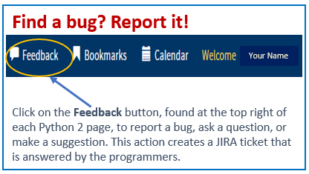
Python 2 Thesis Support
Faculty and POs:
Routing New Thesis-Proposal Approvals

Slide 2
Python 2 Thesis Support
Departments provide thesis-proposal guidelines and slimmed-down proposal-content templates to students
Students create and route their Thesis Proposal Form (TPF) for approval via Python Thesis Dashboard
Faculty members and program officers record proposal approvals via TPF
1

Slide 3
Python 2 Thesis Support
Summary: For situational awareness
Student, ed tech, program officer, or academic associate creates Thesis Block and Python Thesis Dashboard by following these instructions.
Student enters and confirms/updates information required for the Thesis Proposal Form (TPF) milestone, knowing data can be changed later as research evolves:
Thesis Data section
Thesis Type
Thesis Title
Co-authors
Faculty Advisors
Proposal Abstract (n/a, if not required by dept.)
Keywords
Relevancy Topics
SharePoint URL
Security and Compliance sections
Security classification and distribution statement for Main Document and Final Abstract
Compliance Tasks by Student
Compliance Tasks by Advisor
Student routes the TPF online in Python: Open and review form, answer funding question, and select “Start Document Routing” in the Student Acknowledgement section.
Advisors, PO, AA, and Department Chair sequentially record their approvals on the TPF.
For more information on what students enter on their dashboard, see “Students: Routing Your Thesis Proposal” on the TPO website: http://my.nps.edu/web/ thesisprocessing/python-help
2

Slide 4
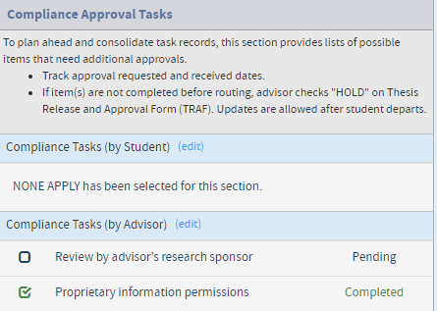
Python 2 Thesis Support
**Faculty Advisors** Please review or complete the following under Security and Compliance
Compliance Tasks:
The purpose of this section is to help you and your students build in time and track progress toward gaining approvals for compliance tasks that can add time to student research.
Relevant task(s) or “None Apply” must be selected in each of the two sub-sections before routing the TPF:
By student
By advisor
Students and advisors can enter and edit data in each other’s section.
You will receive a notification when your student has made selections in either of these subsection. The email will ask you to 1) review the student’s choices and 2) complete the “Compliance Tasks by Advisor” section if the student hasn’t completed it for you.
Click on the (edit) button next to each of these sections to open its data-entry window (see following slides).
Once data is entered in the Edit Compliance pop-up windows, items selected and their status are displayed on the dashboard itself as Pending or Completed. Items are pending until a “completed” date is recorded in the data-entry window.
3

Slide 5
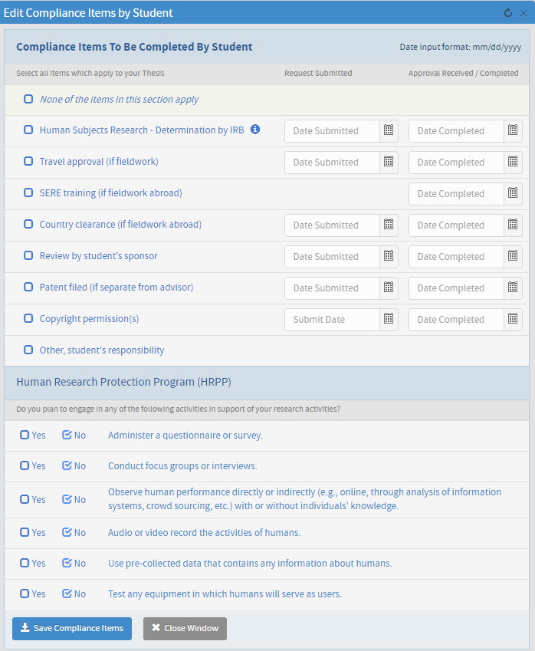
Python 2 Thesis Support
Compliance Tasks (by Student)
Action: Review student’s selections
TRACKING (optional except for IRB)
Students check tasks that apply, if any. Most students will check “None of the items in this section apply.”
NOTE: All students must complete the Human Research Protection Program questions, answering Yes or No for each item.
—If “No” is selected for all items in HRPP, then “None of the items in this section apply” above is allowed. —If “Yes” is selected for any items in HRPP, then “Human Subjects protocol review by IRB” auto-checks above. Student’s IRB review and/or protocol number will need to be entered later.
OPTIONAL TRACKING: Students can then use the Request Submitted and Approval Received/Completed columns to keep track of compliance tasks in one place. Dates dates do NOT need to be entered for your thesis to be approved by your department or to be accepted by TPO.
SAVE!
4

Slide 6
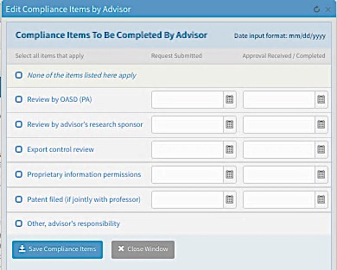
Python 2 Thesis Support
Compliance Tasks (by Advisor)
Action: Review student’s selections or make selections yourself.
Check those that apply, if any. Most advisors (or students for them) will check “None of the items listed here apply.”
OPTIONAL TRACKING: If an item is checked, then the advisor (or student) can opt to use the Request Submitted and Approval Received/Completed columns to keep track of compliance tasks in one place. These dates do NOT need to be entered to have the thesis approved by the department or accepted by TPO.
TRACKING (optional)
SAVE!
5

Slide 7
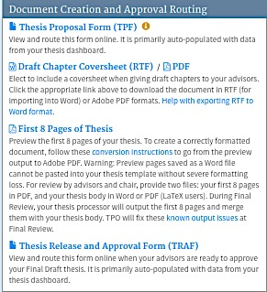
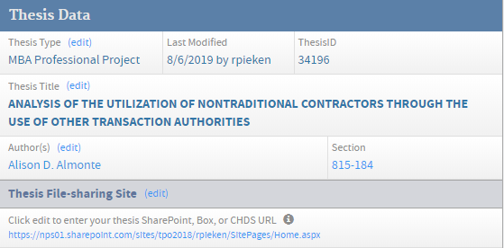
Python 2 Thesis Support
When advisors tell their students they are ready to approve the Thesis Proposal:
Student uploads Thesis Proposal content Student opens TPF document to his/her file-sharing site then… from his/her Dashboard
If you prefer hard copy or email, let your student know.
For SharePoint support, email SharepointAdmins@nps.edu
6

Slide 8
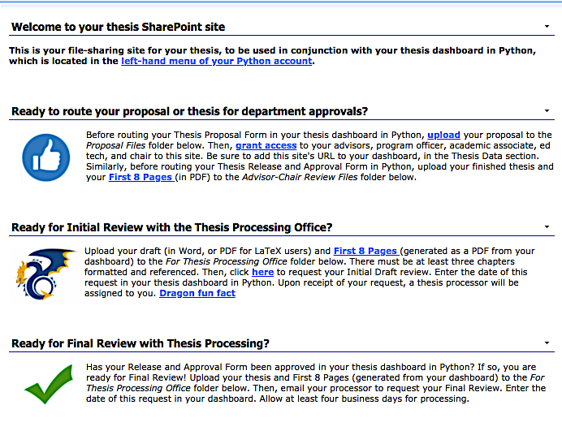
Python 2 Thesis Support
The student’s SharePoint site will look like this.
The site’s documents are located in the Thesis Library, beneath this introductory text.
7

Slide 9
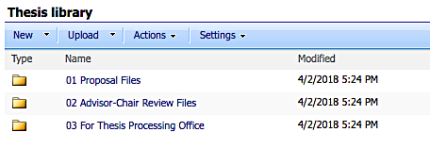
Python 2 Thesis Support
The student should have placed one file in the “01 Proposal Files” folder. Double click on the folder to open it.
June and September 2018 graduates have already been issued their SharePoint sites.
ITACS is issuing SharePoint sites to other current NPS students May 16–31, 2018.
Starting in July 2018, new students will be issued SharePoint sites in their first quarter, after the add-drop period.
8

Slide 10
Python 2 Thesis Support
Tour of the TPF
This is the top of the TPF.
From it, users can navigate to the Thesis Dashboard, Stop Document [TPF] Routing, or print a copy.
Next you’ll see student and advisor information.
Your name
The TPF will list all student authors and their personal and curricular info, as shown here.
Click on someone’s name to display a pop-up window with the person’s contact information.
9

Slide 11
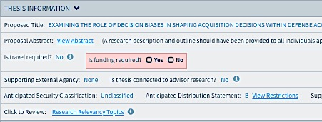
Python 2 Thesis Support
The next section is primarily derived from the dashboard data, but needs the student to complete one question.
Student answers the question in red, and enters a dollar amount if the answer is Yes.
10

Slide 12
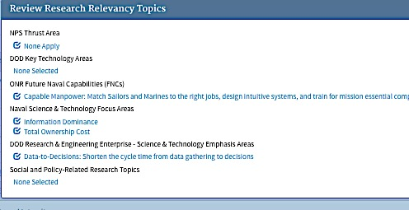
Python 2 Thesis Support
Review the displayed and hidden data.
Click on the three underlined, light-blue phrases to generate pop-up summary boxes for hidden data.
C
11

Slide 13
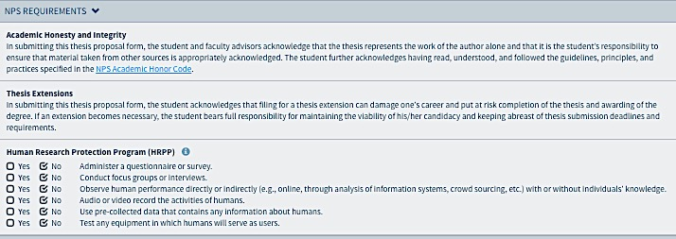
Python 2 Thesis Support
Students are advised to read this section carefully.
IRB data are populated on the TPF from answers given in the “Compliance Tasks by Student” section of the dashboard.
Students read this section and click on the “Start Document Routing” button.
The TPF is routed first to student author(s), then to faculty advisors, PO, AA, and department chair.
12

Slide 14
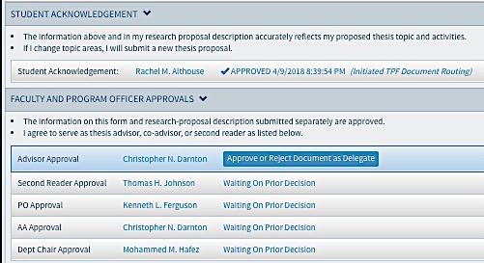
Python 2 Thesis Support
This is what the TPF looks like after the student has started routing.
DELEGATES: Ed Techs and program officers (POs) can record approvals on the TPF by acting as delegates for non-NPS faculty advisors.
Ed techs and program officers can also serve as delegates for NPS faculty advisors.
POs, AAs, and department chairs usually have delegates identified in Python.
Delegates do NOT receive notification of pending approval action needed, but can find pending approval requests in their Thesis Inbox. Delegates act when asked to do so.
Student’s name
Each faculty member and program officer is sent an email notification, in turn, letting them know the student’s TPF is awaiting their approval.
They access the student’s TPF via their Thesis Inbox or your dashboard.
They access student’s thesis-proposal content via the SharePoint site URL on the dashboard, hard copy, or emailed copy, depending on their expressed preference.
13

Slide 15
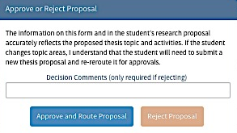
Python 2 Thesis Support
Each reviewer has the option to approve or reject the TPF data or proposal content.
Your name
If you reject the TPF or proposal, enter a short explanation as to why. This is sent to the student.
The student contacts you for more information or makes the requested changes and then re-starts the routing from the beginning so that everyone is approving the same information.
14

Slide 16
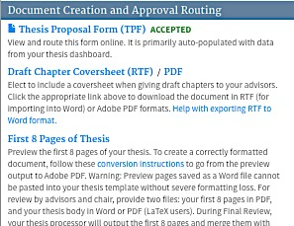
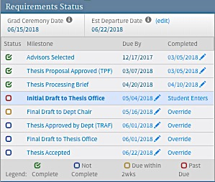
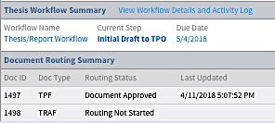
Python 2 Thesis Support
The dashboard records the TPF as “completed” in three places, circled below:
Middle-left of dashboard
Top right
Bottom left
You’re done!
15

